Slide 1


Very Large Baseline Array (VLBA) Data Analysis
Corey Miner
Mike Parker
2018 Statewide Symposium
Tucson Arizona
Notes:
Hi my name is Corey Miner, and I worked with Mike Parker at Rincon Research to take on the problem of Data saturation in VLBA radio telescopes

Slide 2
VLBA Radio Telescopes

Slide 3
Background
Rincon Research recently started working with the National Radio Astronomy Observatory (NRAO) to analyze data from VLBAs.
NRAO’s standard data recording (2 bit quantization)
Rincon Research’s data collection (12 bit quantization)
Data altered between three different known points:
Quasar
Inmarsat transmitting WAAS (GPS-like signal)
GPS Satellite

Slide 4
Data Analysis
Two different data collections had been taken:
Data from Kitt Peak AZ in June
Data from Kitt Peak AZ and Pie Town NM in July
There was something wrong with the data when the VLBA radio telescope was pointed at a strong satellite signal.
We hypothesized this was attributed to strong signal saturation

Slide 5
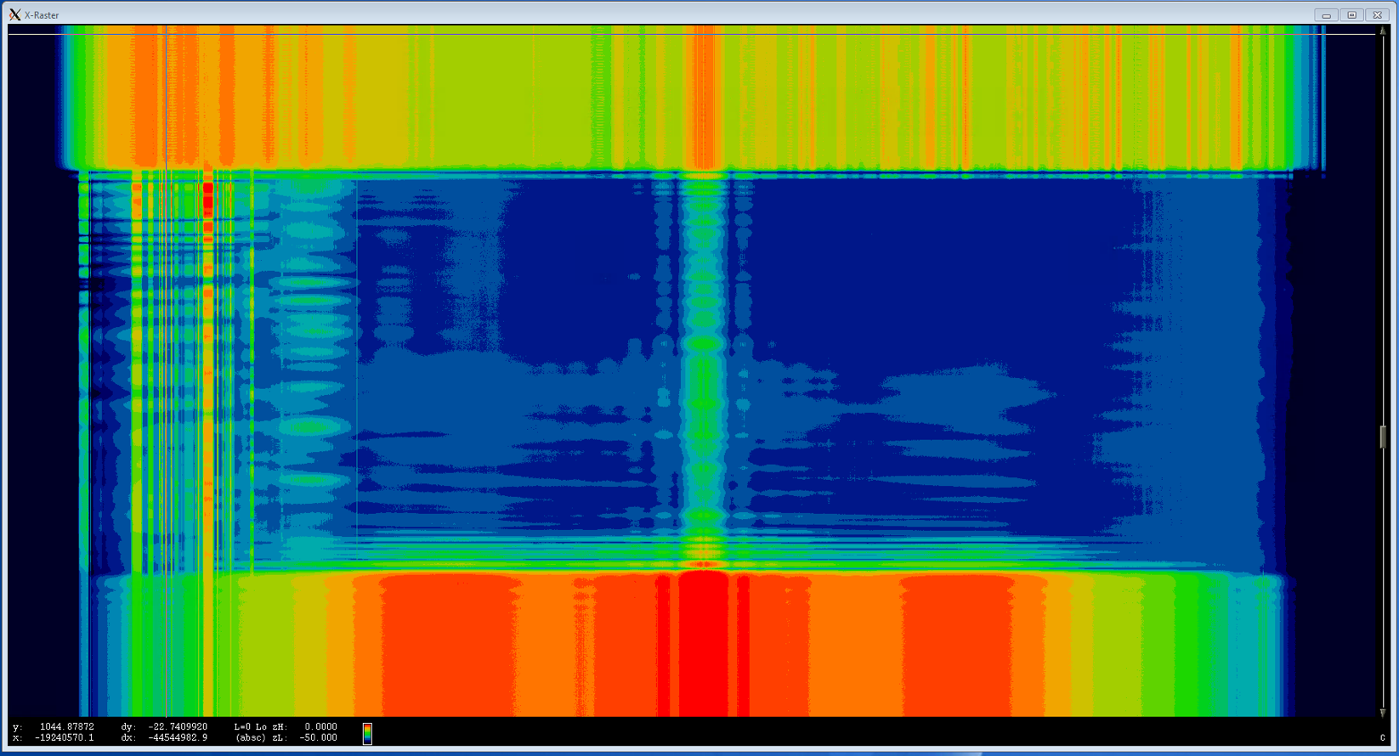
Raster as antenna points from Inmarsat to GPS
Communication
signals
WAAS
Signal
Focused on Inmarsat
Time
(75 sec)
Antenna slew in progress.
Focused on GPS
1550 MHz
1575 MHz
1600 MHz

Slide 6
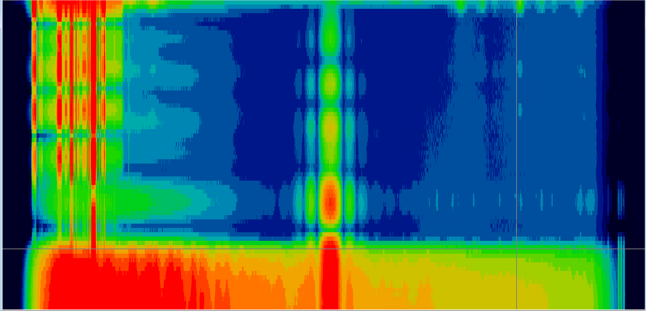
Possible Saturation With Inmarsat
Communication
signals
WAAS
signal
Slew onto
Inmarsat
Showing
4 sidelobes
Time
(5 sec)
Pointing
At Inmarsat
1550 MHz
1575 MHz
1600 MHz
Notes:
Start maybe a minute after slew staarted 1920Z

Slide 7
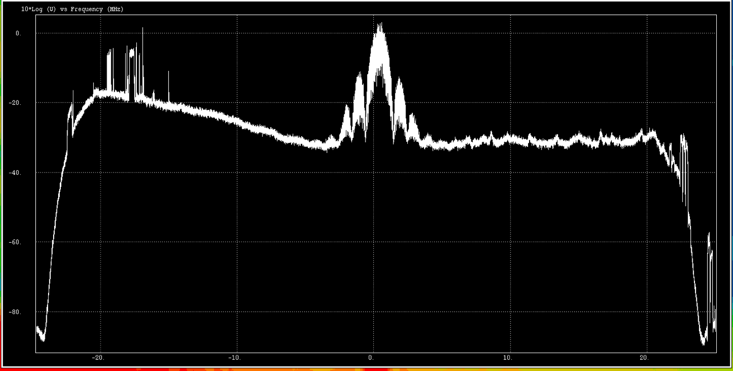
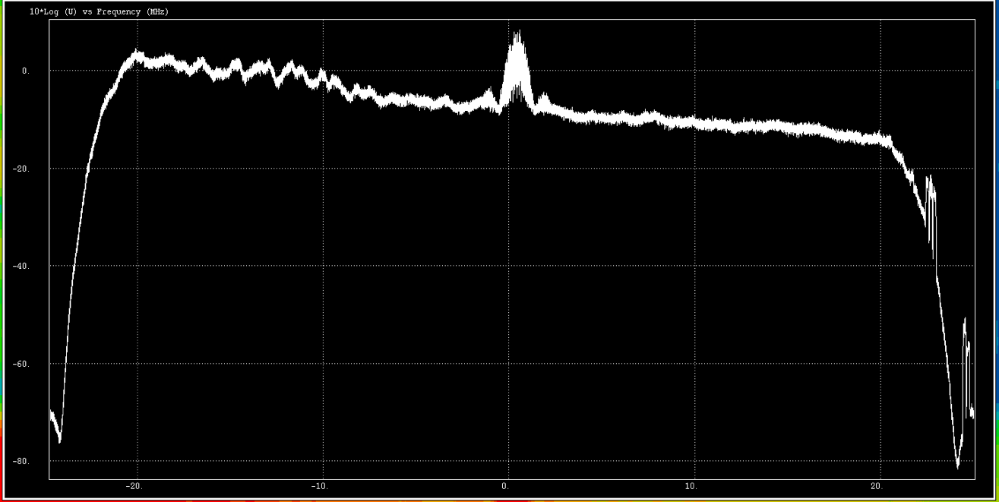
Possible Saturation With Inmarsat Cont.
Reasonable Signal
Side lobes and com. signals are visible
Amp(dB)
WAAS
signal
Signal Highly Distorted
Side lobes and com. signals not visible
Amp(dB)
1550 MHz
1575 MHz
1600 MHz

Slide 8
Next Steps: Get a third opinion
Go to Kitt Peak and use a Spectrum Analyzer to record data
Record a wider frequency bandwidth to see out-of-band signals that might be causing saturation

Slide 9
Thank You
Acknowledgements:
Mike Parker
Randal Thornley

